Slide 1
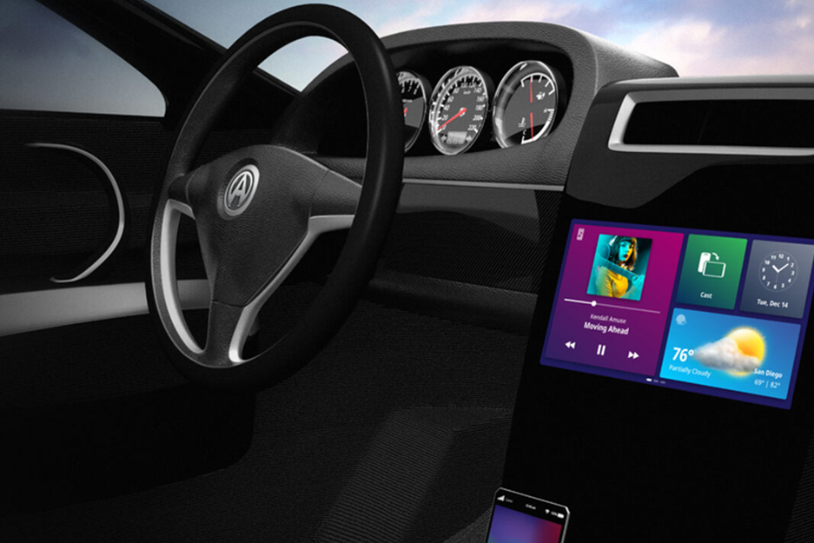
Title: Personalized in-car Systems Using Generative AI
Team Member Details:
Name | College Name
Maithili Marbate | G. H Raisoni College Of Engineering
Khushi Shende | G. H Raisoni College Of Engineering
Sakshi Tayade | G. H Raisoni College Of Engineering
Image ref: https://abaltatech.com/blog/2023/02/upgrade-your-ride-personalize-your-car-infotainment-to-maximize-enjoyment/

Slide 2
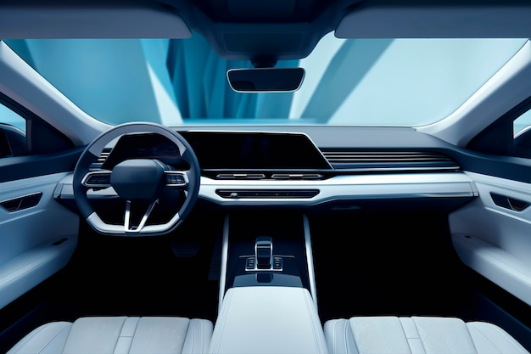
OVERVIEW
1. Creation of an AI-powered in-car system that adjusts to the preferences of each user
2. Smooth interaction with car features for proactive support and improved experience
3. Will use cutting-edge AI and Internet of Things technology to transform the driving experience completely.
Image ref: https://img.freepik.com/free-photo/view-3d-car-interior_23-2151138888.jpg

Slide 3




PROBLEM STATEMENTS
Safety Issues | Insufficient Customization | Ineffective Maintenance and Driving | Restricted User Experience and Connectivity
Automobile Safety Industry Growth : • Global industry expected to reach $200 billion by 2025. • Regulatory requirements and public awareness could reduce accidents. • Increased demand for advanced safety technology. | Automobile Customisation Market Size and Future Prospects : • Global market expected to reach $38 billion by 2026. • Growing demand for personalized car experiences driving innovation in AI-driven customization. | Global Automotive Aftermarket Market Size : • Proposed to be worth $486 billion by 2025. • Predictive maintenance and fuel optimization technology can reduce costs, increase vehicle longevity, and enhance environmental sustainability. | Connected Automobile Market Growth : • Infotainment and connection solutions segment estimated at $50 billion in 2023. • CAGR projected to reach $90 billion by 2028. • Future prospects driven by smart ecosystems and continuous connectivity.

Slide 4
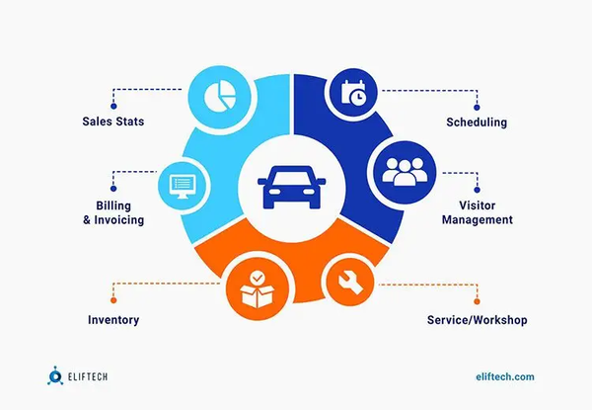
Approach
OBJECTIVES AND APPROACH
1.Improvement of Safety
Real-Time Monitoring
Proactive Alerts
Adaptive Cruise Control
2. Individualization
User profiles
Machine Learning
3. Optimization of Efficiency
Fuel Optimization
Apply data analytics
4. Improved Communication
Voice Control
Integration with cellphones
Smart Home Connectivity
Objectives
Boost Safety
Customize Experience
Boost Efficiency
Boost Connectivity
Image ref: https://www.eliftech.com/insights/custom-automotive-solutions-development/

Slide 5




SOLUTIONS
Artificial Intelligence-Powered Safety Features Real-time monitoring uses sensors and computer vision to monitor driver behavior. Proactive Alerts: AI systems that identify risks and sound alarms. Adaptive Cruise Control: Maintains safe distances and automatically modifies speed. | Individualized In-Car Experience User profiles: Adaptable infotainment, temperature, and seat settings. Machine Learning: Modifies parameters in response to driving habits and preferences. Adaptive Climate Control: Climate settings are automatically adjusted. | Efficiency Enhancement Fuel Optimization: Real-time advice for driving on eco-friendly, fuel-efficient routes. Notifications of impending maintenance requirements: Predictive maintenance. Performance analytics: Finds trends for more efficient fuel use. | Improved Communication Advanced natural language processing for hands-free operation is integrated into voice control. Integration with smartphones: Smooth media and navigational connections. Smart Home Connectivity: Manage household appliances from your vehicle. User-friendly design.

Slide 6








CHALLENGES FACED AND TECH STACK
Challenges Faced
Privacy and Security
User Acceptance
Real-Time Performance
Adaptability and scalability
Tech-Stack

Slide 7
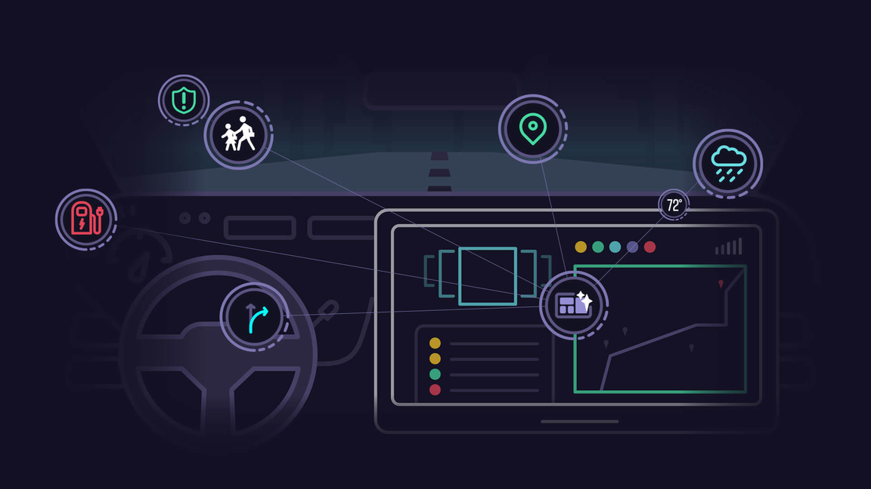
TECHNICAL IMPLEMENTATIONS
Hardware Integration Central Processing Unit (CPU) and Graphics Processing Unit (GPU) Display Sensors Connectivity Audio System | Software Development Operating System Application Framework | Machine Learning and Personalization Data Collection User Profiles Recommendation engine Behavior Prediction | User Interface Dashboard Layout Voice Control Gestures and Touch Notifications
Image ref: https://www.telenav.com/blog/predictive-and-personalized-how-to-deliver-the-digital-driving-experience-consumers-want

Slide 8
RESULTS AND ACHIEVEMENTS
RESULTS
ACHIEVEMENTS
1) Enhanced User Satisfaction:-
1) Personalized Experience
2) Ease of Use
2) Improved Safety:-
1) Reduced Distraction
2) Health Monitoring
3) Increased Efficiency:-
1) Optimized Navigation
2) Eco-Friendly Driving
4) Better connectivity:-
1) Seamless Integration
2) IoT Integration
1) Technology Advancement:-
1) AI and Machine Learning
2) AR Integration
2) Market Leadership:-
1) Innovation Recognition
2) User Adoption
3) Safety Milestones:-
1) Reduction in Accidents
2) Health Alerts
4) Environmental Impact:-
1) Fuel Savings
2) Sustainability Initiatives

Slide 9
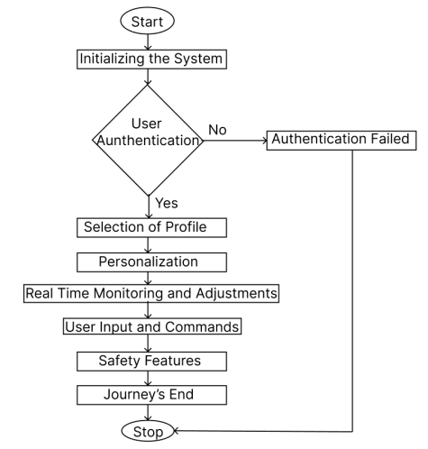
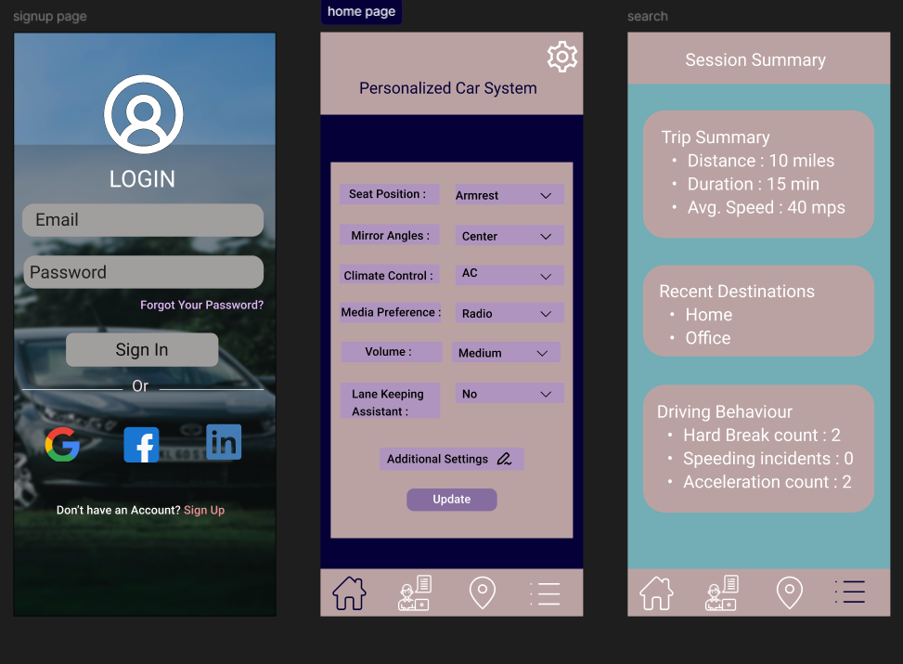
FLOWCHART AND PROTOTYPE
Flowchart
Prototype

Slide 10
DEMONSTRATION AND FUTURE ENHANCEMENT
Demonstration
Scenario: You’re using a state-of-the-art adaptive infotainment system in a car designed to adjust to your driving habits and preferences dynamically.
1. Personalized Welcome
2. Adaptive Music & Media
3. Intelligent Navigation
4. Contextual Voice Assistance
5. Safety and Driving Adaptations
6. Learning and Adjusting
7. Evening Transition
Future Enhancement
1)Personalized Recommendations:-
Music and Media
Navigation
2)Voice and Gesture Recognition
3)Artificial Intelligence Integration
4)Health Monitoring
5)Enhanced Connectivity

Slide 11
PROJECT PLAN
Research & Feasibility Study
Prototype Development
Data Collection & Model Training
IoT & Connectivity Implementation
User Testing & Feedback
Security & Privacy
Market Analysis
Technology Evaluation
Concept Development.
System Design
Integration
Initial Testing
Data Acquisition
Model Development
Validation
Sensor Integration
Connectivity Setup
System Testing
Beta Testing
Feedback Collection
Refinement
Implementation
Security Protocols
Privacy Policies

